Slide 1

House Prices: Advanced Regression Techniques
Team: Project-KC
Presented by:
Lohidhar Kolla U08206440
Srivalli Chintapalli U26366427
Santhosh Kunooru U57217608

Slide 2

Problem Statement
House price predictions play a critical role in real estate decision making
The dataset has 79 explanatory variables describing almost every aspect of residential homes

Slide 3

Motivation for the project
Leveraging advanced data analytic techniques to predict an accurate sale price for each house
The project uses:
Advanced regression techniques
Feature engineering
Data cleaning techniques

Slide 4
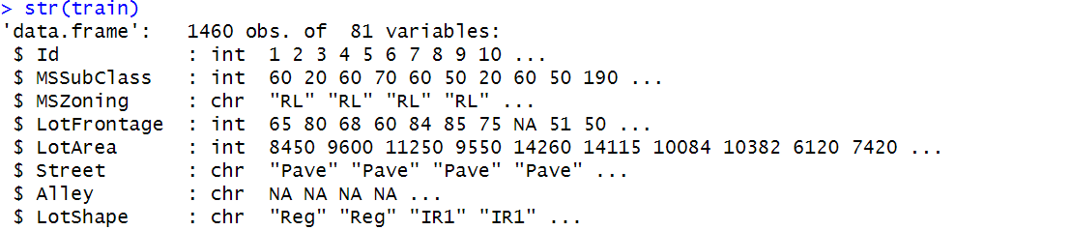
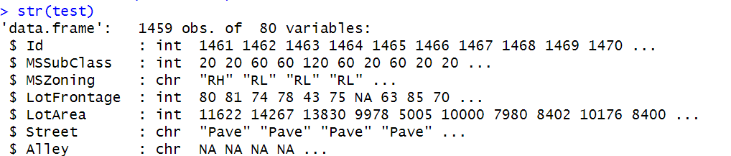
Description of the data set

Slide 5
Flowchart
Step 1
Data visualization
Facilitate understanding
Patter Recognition
Step 2
Data cleaning
Imputation for missing values
Outliers
Step 3
Feature selection
Correlation matrix
Log transformations
Step 4
Model selection
Interpretability of data
Increase robustness
Step 5
Validation &
Predictions

Slide 6
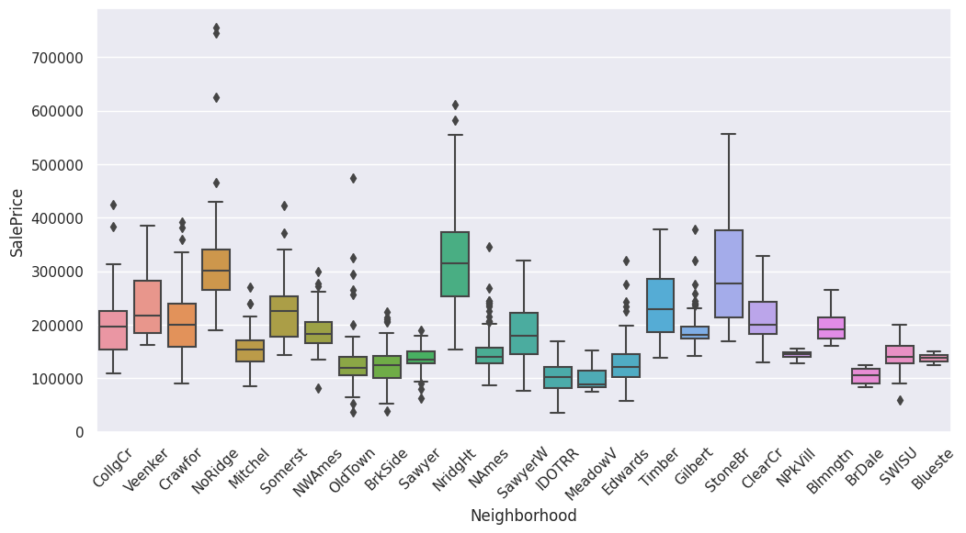
Data Visualization

Slide 7
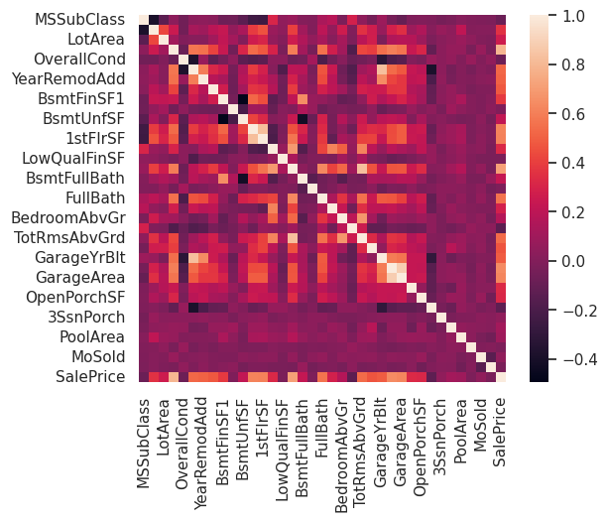
Correlation Map
OverallQual | 0.790982
GrLivArea | 0.708624
GarageCars | 0.640409
GarageArea | 0.623431
TotalBsmtSF | 0.613581
1stFlrSF | 0.605852
FullBath | 0.560664
TotRmsAbvGrd | 0.533723
YearBuilt | 0.522897
YearRemodAdd | 0.507101
GarageYrBlt | 0.486362
MasVnrArea | 0.477493
Fireplaces | 0.466929
BsmtFinSF1 | 0.38642
LotFrontage | 0.351799
WoodDeckSF | 0.324413
2ndFlrSF | 0.319334
OpenPorchSF | 0.315856

Slide 8

Models developed
Linear Regression
Curated a LR model depending on the correlation w.r.t to SalePrice
Ridge Regression
Selected lambda using CV method
Random forest
Used a K-fold Cross validation
Extra trees Regressor
To reduce variance in the dataset
XG boost
Help to prevent overfitting

Slide 9
Best approaches
Random forest:
K-fold cross validation with 10 folds to validate the model
Used features that had high correlation to Sale Price
It finds the optimal split for each node.
Extra Trees Regressor or Extremely Randomized Trees:
Splits are chosen randomly than compared to Random Forest
Can handle high variance and bias in the data
No.of trees=800,max. features=sqrt(cols(X_train)),Sample without replacement
It uses Random Threshold for each features to split nodes, which adds additional randomness to the model
Ensemble model:
Can combine multiple diverse models for better predictive performance
RF:0.2,ExtraTrees Regressor:0.4,XG Boost:0.4

Slide 10
Results

Slide 11

Challenges
Feature Selection and Engineering
Dealing with categorical variables and Outliers
Skewed Data
Data Quality and Missing Values
Hyperparameter Tuning
Computational Resources and Time Constraints
Time Management
Domain knowledge regarding the dataset

Slide 12

Thank you -Project-KC

